Slide 1

Automatic Invoicing
Process Definition Document (PDD)
Complete UiPath RPA Developer – Final Project
Notes:
https://pixabay.com/id/photos/mesin-ketik-buku-catatan-kertas-801921/

Slide 2
Introduction
1
Document and process introduction

Slide 3
1.1 Introduction
About This Document
The Process Definition Document outlines the business process chosen for automation using UiPath Robotic Process Automation (RPA) technology. The document describes the sequence of actions performed as part of the business process, and the document serves as a base for developers, providing them with the details required for applying robotic process automation to the selected business process.
Table of Contents
Introduction Document Introduction Process Description Process Diagram Application Overview Automatic Invoicing Open invoice spreadsheet Open invoice-generator.com Enter invoice details Download invoice Close invoice-generator.com Attachments Excel spreadsheet containing invoice data

Slide 4
1.2 Process Description
General Process Description
This document concerns the process of generating invoices at invoice-generator.com. The process is performed manually by navigating to invoice-generator.com. Here, invoices are generated by manually filling out the web-based form based on data made available to the individual performing the process in an excel spreadsheet.
Automation Objectives
The business objectives and benefits expected by the Business Process Owner after automation of the selected business process are: Reduce processing time per item by 90% Reduction and/or elimination of manual errors during invoice generation Improved consistency of process execution as the robot can be scheduled to run at any time

Slide 5
1.3 Process Diagram

Slide 6
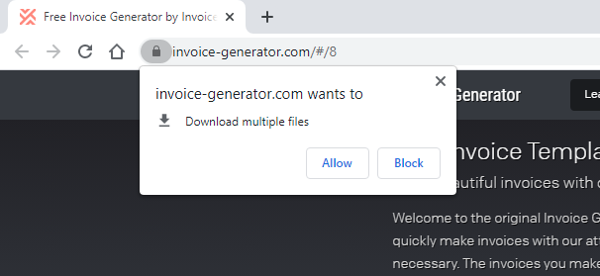
1.4 Application Overview
Application used as part of the process | Comment
Microsoft Excel | Invoice data is read from an excel document. Filetype: .xlsx
Google Chrome | Invoices are generated in Google Chrome. You may be asked by Google Chrome to allow download of multiples files. If so, select Allow.

Slide 7
Automatic Invoicing
2
Detailed description of process actions

Slide 8
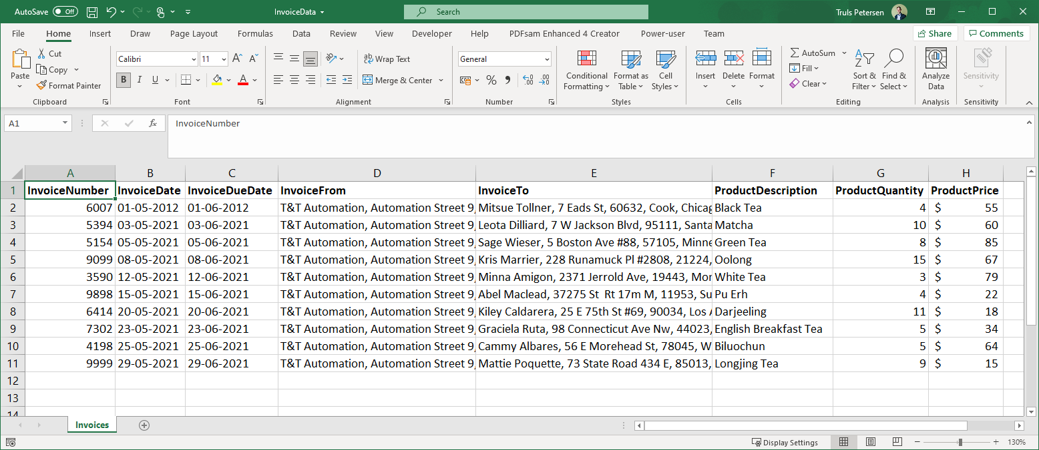
2.1 Open Invoice Spreadsheet
Screenshot
Description
Open InvoiceData.xlsx This spreadsheet contains all the necessary information to generate one invoice per row. Document pre-requisites The name of the spreadsheet is Invoices The following columns exist in the table: (1) InvoiceNumber, (2) InvoiceDate, (3) InvoiceDueDate, (4) InvoiceFrom, (5) InvoiceTo, (6) ProductDescription, (7) ProductQuantity, (8) ProductPrice
1

Slide 9
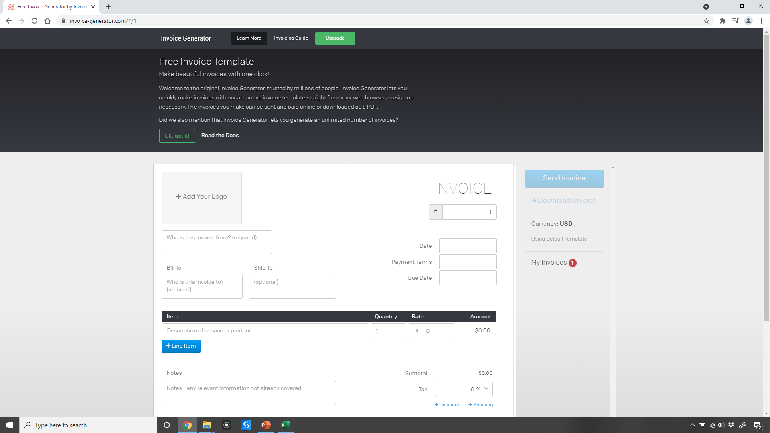
2.2 Open invoice-generator.com
Screenshot
Description
Open Google Chrome Navigate to invoice-generator.com When entering the website for the first time, you may have to perform this third activity to remove the welcome message. This is needed only once, unless you clear your browser history. Click Ok, got it!
2
3
1

Slide 10
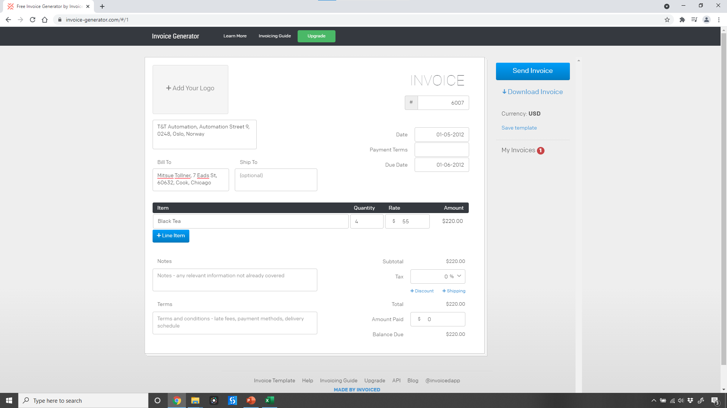
2.3 Enter Invoice Details (all)
Screenshot
Description
Enter Invoice From Enter Invoice To (Bill To) Enter Invoice Number Enter Date Enter Due Date Enter Item Description Enter Item Quantity Enter Item Rate/Price
3
1
4
2
5
6
7
8

Slide 11
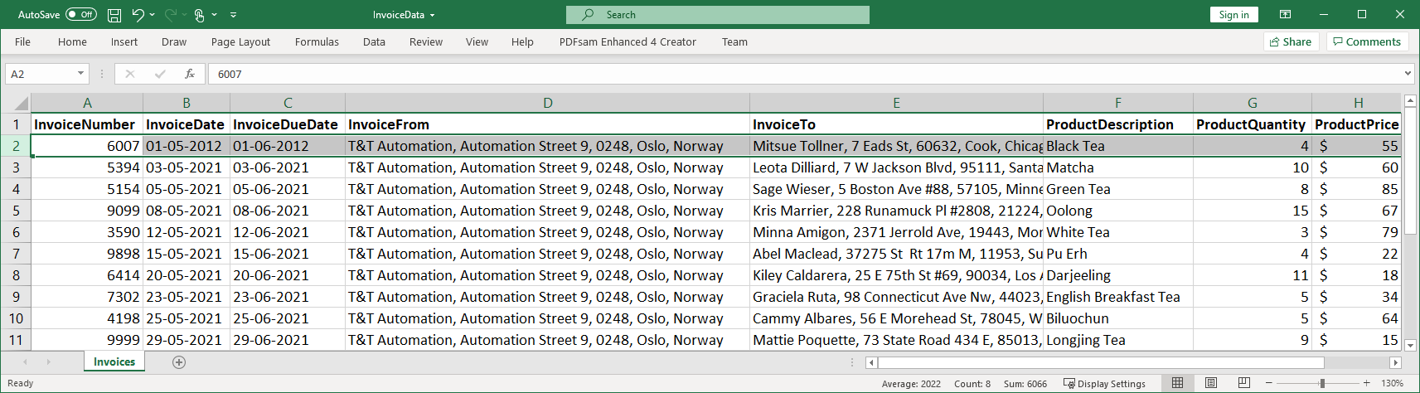
2.3 Enter Invoice Details: Invoice from
Screenshot
Description
Enter Invoice From
1

Slide 12
2.3 Enter Invoice Details: Invoice To
Screenshot
Description
Enter Invoice To (Bill To)
2

Slide 13
2.3 Enter Invoice Details: Invoice Number
Screenshot
Description
Enter Invoice Number
3

Slide 14
2.3 Enter Invoice Details: Invoice Date
Screenshot
Description
Enter Date
4

Slide 15
2.3 Enter Invoice Details: Invoice Due Date
Screenshot
Description
Enter Invoice Due Date
5

Slide 16
2.3 Enter Invoice Details: Item Description
Screenshot
Description
Enter Item Description
6

Slide 17
2.3 Enter Invoice Details: Item Quantity
Screenshot
Description
Enter Item Quantity
7

Slide 18
2.3 Enter Invoice Details: Item Rate/Price
Screenshot
Description
Enter Item Rate/Price
8

Slide 19
2.3 Download Invoice (1/2)
Screenshot
Description
Click Download Invoice
1

Slide 20
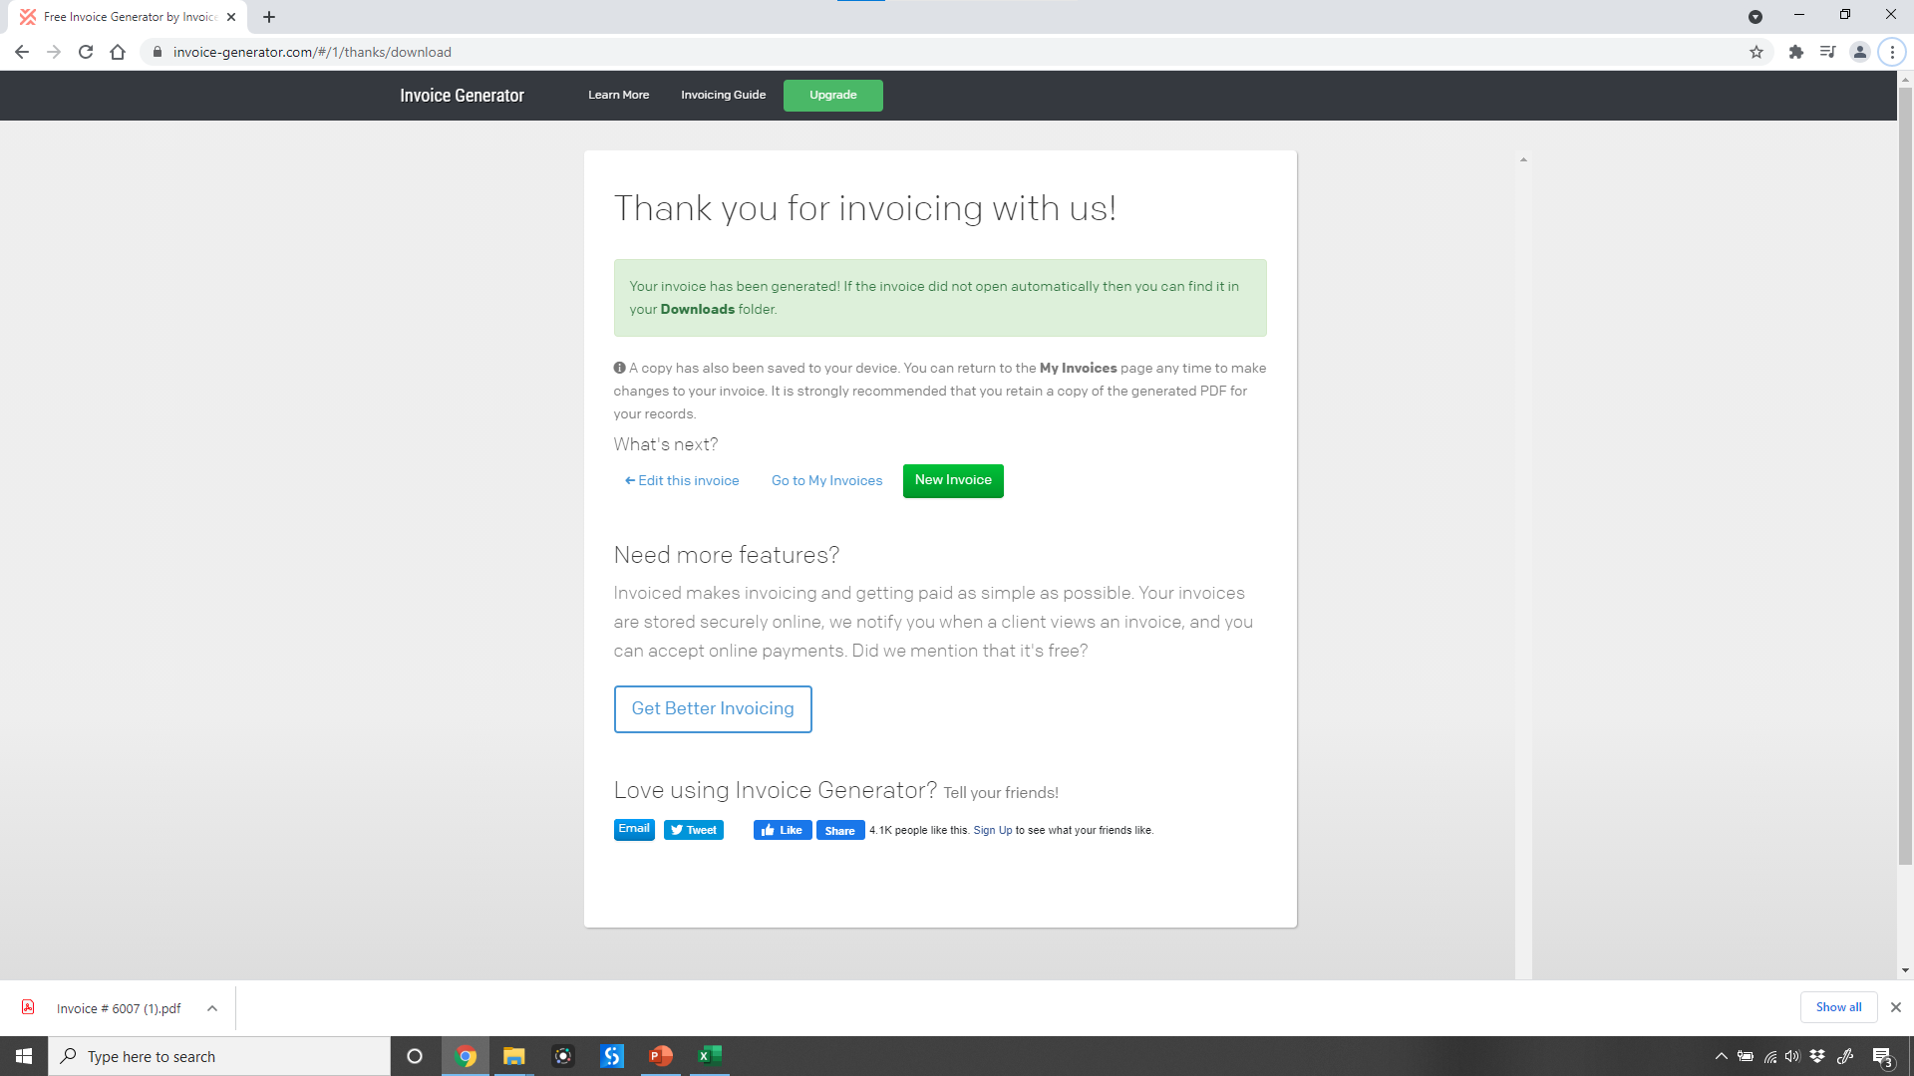
2.3 Download Invoice (2/2)
Screenshot
Description
Confirm Successful download Click New Invoice to return to home page to prepare for next invoice You may be asked by Google Chrome for permission to download multiple documents. Follow the action below to allow multiple downloads from this webpage. This is required to do once: Click Allow
3
2
1

Slide 21
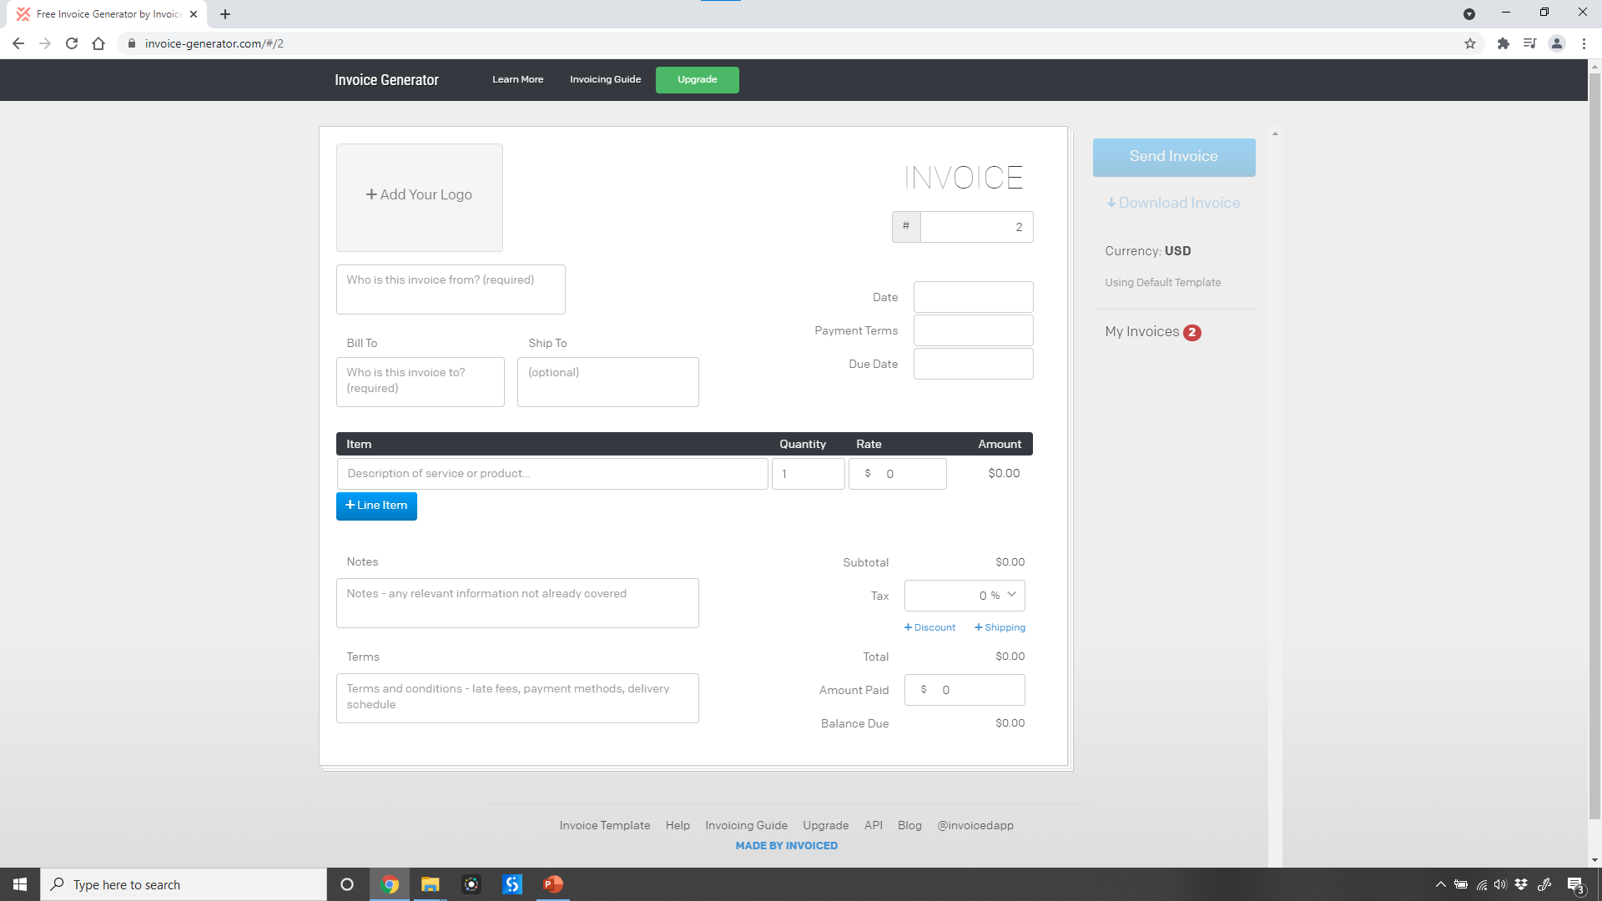
2.3 Close invoice-generator.com
Screenshot
Description
Close invoice-generator.com open in Google Chrome You can either close the tab or the entire window.
2

Slide 22
Attachments
3

Slide 23
3.1 Excel Spreadsheet
Screenshot
Description
InvoiceData.xlsx This spreadsheet contains all the necessary information to generate one invoice per row. Document pre-requisites The name of the spreadsheet is Invoices The following columns exist in the table: (1) InvoiceNumber, (2) InvoiceDate, (3) InvoiceDueDate, (4) InvoiceFrom, (5) InvoiceTo, (6) ProductDescription, (7) ProductQuantity, (8) ProductPrice
1

